Slide 1





Project Presentation
IoT-Based Smart Medicine Box

Slide 2


Introduction
The Smart Medicine Box is an IoT-based healthcare solution that helps prevent missed or forgotten medications. Powered by an ESP32 and integrated with the Blynk app, it automatically opens scheduled compartments, triggers alarms, and sends real-time alerts to caregivers. IR sensors confirm whether the dose is taken, while a DHT11 sensor monitors storage conditions to keep medicines safe. This system enhances medication adherence and provides greater peace of mind for patients and families.

Slide 3

Our Team
Rabia
Laiba
Malika

Slide 4
Project Goals
Automated Alerts: Sound and visual cues at specific times.
IoT Monitoring: Remote tracking of medication via a smartphone app.
Environmental Monitoring: Tracking storage conditions (Temp/Humidity).
Safety: Automatic locking/closing of compartments if a dose is missed.
Compliance Verification: Using IR sensors to confirm if the medicine was actually taken

Slide 5
Problems
The Issue
Consequences
Forgetfulness in taking medication (especially for the elderly or those with chronic illnesses).
Reduced treatment effectiveness, health complications, and hospital readmissions.

Slide 6
Software & Logic Flow
1
2
3
Confirmation Logic:
Success: IR Sensor detects movement → System resets → App updated.
Missed Dose: 60-second timeout → Lid closes → "Missed Dose" alert
The Alert Cycle: 1. Pre-set timer triggers. 2. Buzzer/LED turns ON + App notification sent. 3. Servo opens the specific compartment.
Initialization: Connects to Wi-Fi and Blynk; sets servo positions to "Closed."

Slide 7
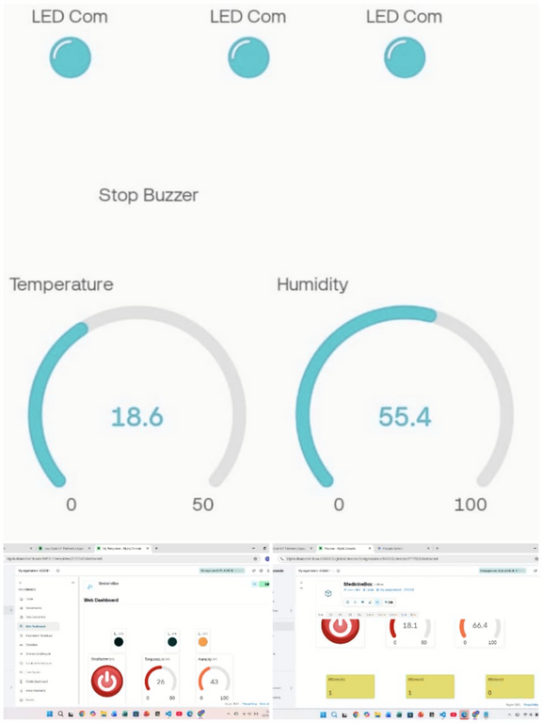
IOT Integration
1
2
Real-time Dashboard: View Temperature and Humidity graphs.
Live Status: Indicators for each IR sensor (V10-V12).
Events: Push notifications for "Medicine Time" and "Missed Dose."
Remote Control: A "Silence" button (V1) to stop the buzzer manually.

Slide 8
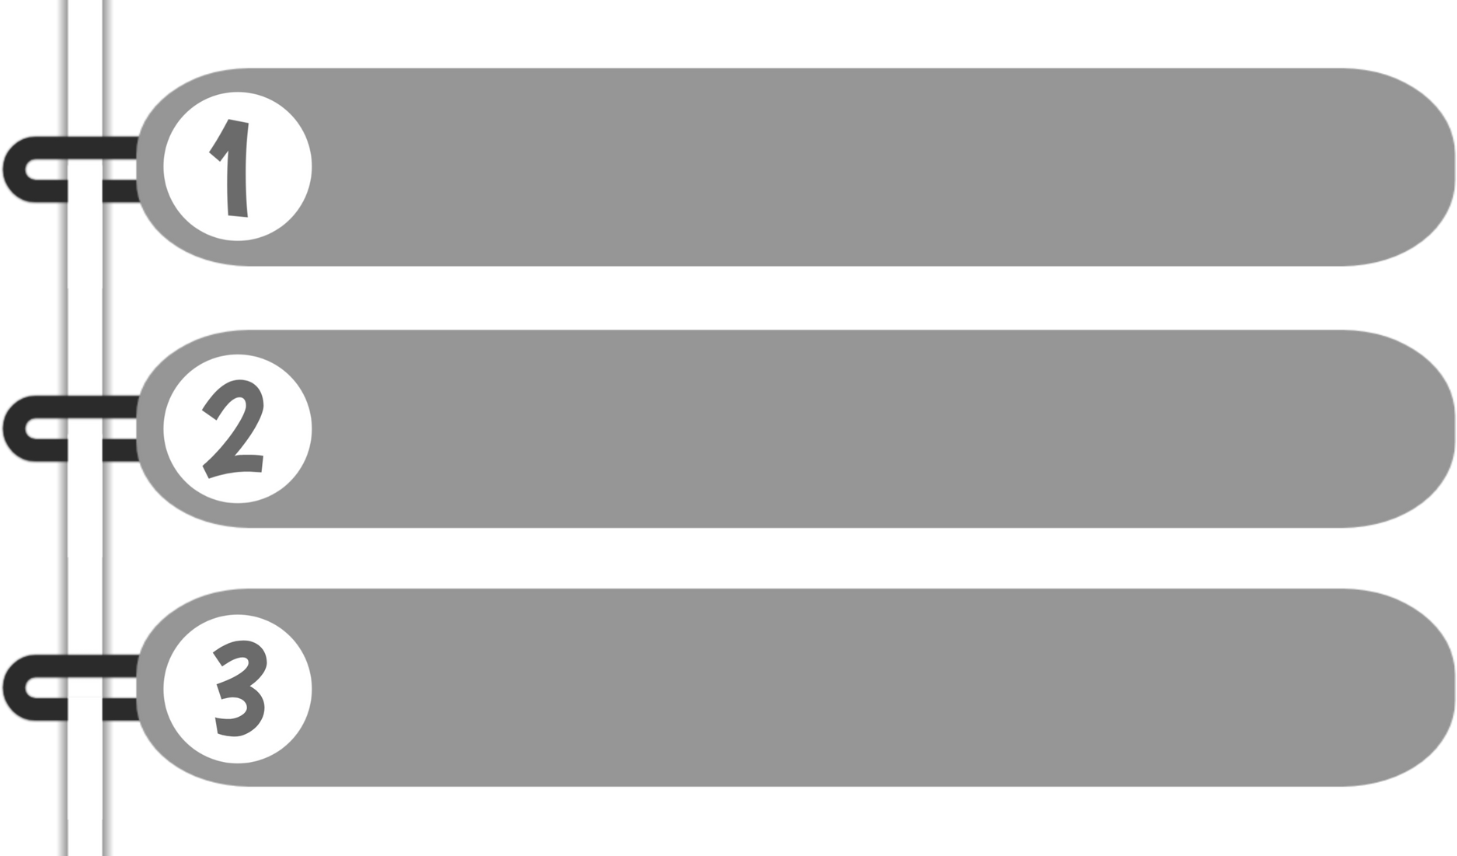
Hardware Components
ESP32: Main controller with built-in Wi-Fi.
Servos (MG90S): Mechanically opens/closes 3 separate compartments.
IR Sensors: Detects hand movement to verify medicine retrieval.
DHT11: Monitors if pills are stored in safe temperature/humidity.

Slide 9
Advantages & Future Scope
Advantages
Future Scope
Integration with Google Assistant for voice reminders.
Face recognition to ensure the correct person takes the pill.
Reorder system that texts the pharmacy when pills are low.
Reduces human error.
Allows caregivers to monitor patients remotely.
Compact and low power consumption.

Slide 10
Conclusion
The Smart Medicine Box is a life-saving tool that bridges the gap between healthcare and IoT.

Slide 11
Q&A Session

Slide 12
Thank You

